Slide 1





TITLE:-
UNVEILING THE CODE OF LIFE - A PREDICTION
MODEL

Slide 2

TEAM MEMBERS
SHASHMITA SANYAL
REG. NO.:- 22BHI10034
SHREYA RAJ GUPTA
REG. NO. :- 22BHI10143
JIGISHA DHARSKAR
REG. NO.:- 22BHI10050
ISHA CHOUDHARY
REG. NO. :- 22BHI10124

Slide 3

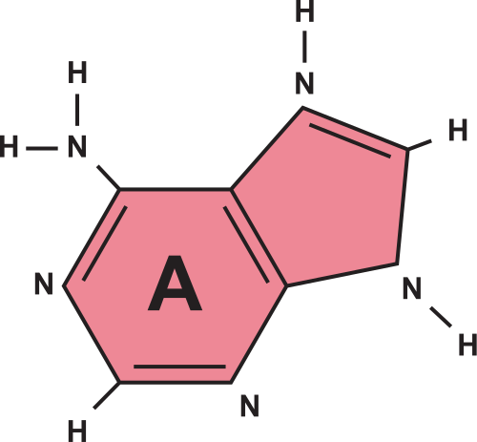

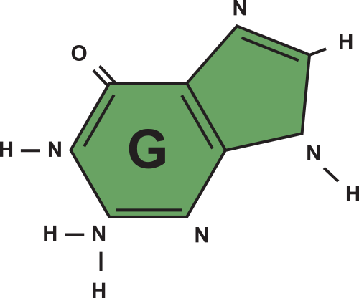
GUIDE
Introduction
Objective statement
Modules & Explanation
Overall system architecture diagram
References
Conclusion

Slide 4

UNVEILING THE CODE OF LIFE
Objective
What diseases we hope to predict susceptibility

Slide 5

Objective
The objective of this study is to develop and evaluate a novel genetic risk prediction framework, which integrates various types of genomic annotations with genome-wide association study (GWAS) summary statistics to improve the accuracy of disease risk prediction, in both extensive simulations and real data, in comparison with state-of-the-art risk prediction methods.

Slide 6

Target Diseases
WHY OUR MODEL NEEDS TO BE MADE
IBD - Crohn’s Disease
Type-II Diabetes
Reduced number of diseases to focus on higher accuracy and efficiency of each model

Slide 7
Crohn's disease is a chronic disease that causes inflammation in the digestive tract. But it usually affects the small intestine and the ascendal large intestine.
Type 2 diabetes is a metabolic disorder characterized by high blood sugar levels resulting from insulin resistance and inadequate insulin production by the pancreas.

Slide 8

UNVEILING THE CODE OF LIFE
LITERATURE
REVIEW

Slide 9


1.Machine Learning-based Prediction Models for Diagnosis and Prognosis in Inflammatory Bowel Diseases: A Systematic Review
Authors: Nghia H Nguyen, Dominic Picetti, Parambir S Dulai, et.al
The paper reviews machine learning models for diagnosing and predicting outcomes in inflammatory bowel diseases (IBD). Authors Nghia H Nguyen et al. surveyed relevant studies, highlighting models' performance, data sources, and key features used for prediction. They emphasize the potential of these models in enhancing clinical decision-making and personalized medicine.
2.Machine Learning Prediction Model for Inflammatory Bowel Disease Based on Laboratory Markers. Working Model in a Discovery Cohort Study
Authors:by Sebastian Kraszewski 1,*ORCID,Witold Szczurek 2,Julia Szymczak
The study by Sebastian Kraszewski et al. introduces a novel machine learning prediction model tailored for inflammatory bowel disease (IBD) diagnosis, leveraging laboratory-based biomarkers.

Slide 10

3.Diabetes Prediction Using Ensembling of Different Machine Learning Classifiers
Authors: Md. Kamrul Hasan; Md. Ashraful Alam; Dola Das; Eklas Hossain; Mahmudul Hasan
The paper by Md. Kamrul Hasan et al. presents a method for diabetes prediction employing an ensemble approach with various machine learning classifiers. By integrating multiple classifiers, including decision trees, support vector machines, and others, the study aims to enhance prediction accuracy.
4.A comparison of machine learning algorithms for diabetes prediction
Author : Jobeda Jamal Khanam, Simon Y. Foo
The paper by Khanam and Foo compares machine learning algorithms for diabetes prediction, analyzing factors like accuracy and sensitivity. Various techniques, including decision trees and neural networks, are evaluated to determine their effectiveness in healthcare applications. The study offers insights into selecting optimal models for improved diabetes prognosis.

Slide 11

UNVEILING THE CODE OF LIFE
Architecture
Datasets, GWAS, Module Split-up

Slide 12
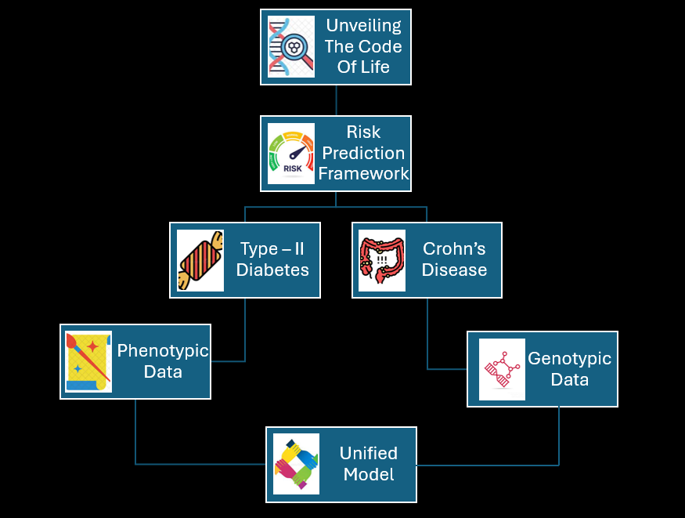

Slide 13

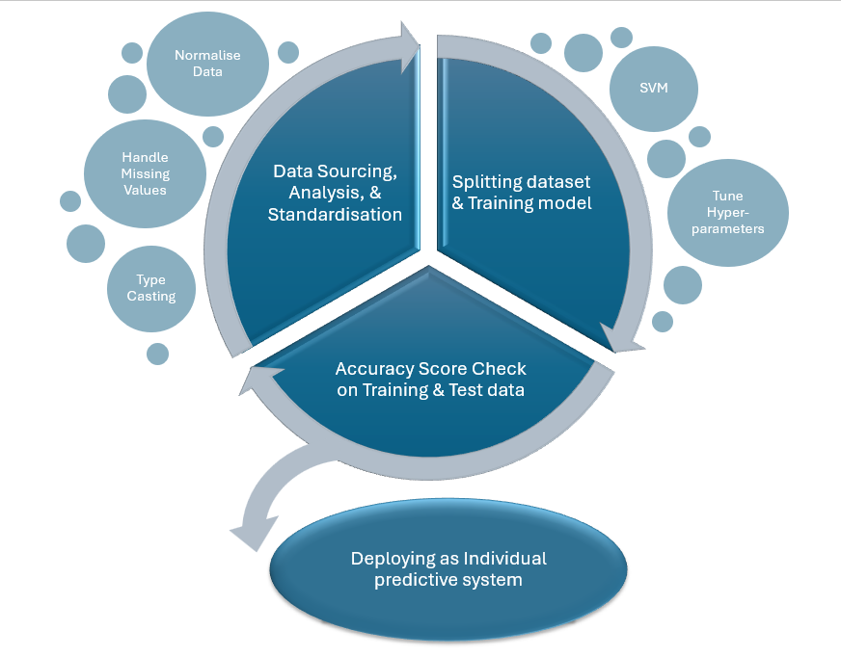
Architecture
Diabetes
Prediction

Slide 14
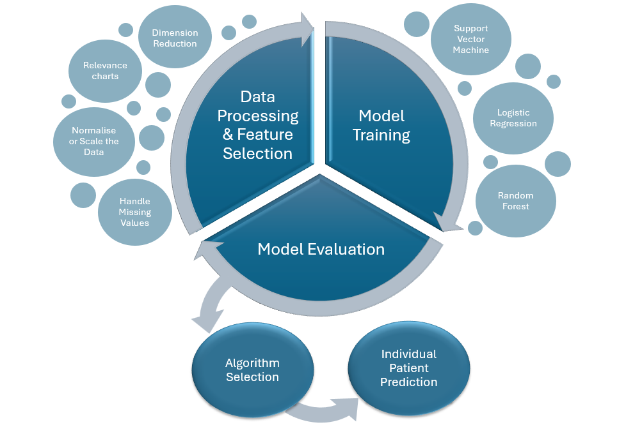
Architecture
IBD
Crohn’s
Disease

Slide 15


WORKFLOW
For Type - II Diabetes

Slide 16

WORKFLOW
For Crohn’s Disease

Slide 17
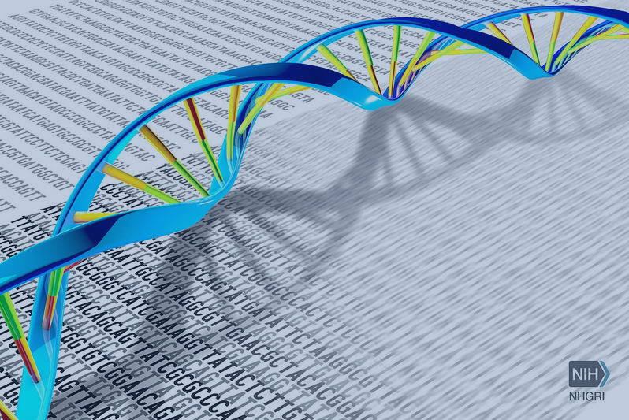
RISK PREDICTION FRAMEWORK
Ground Work

Slide 18

Datasets
TRAINING AND TESTING SOURCES
We shall train our model using publicly accessible GWAS summary statistics with individual-level genotype and phenotype data from cohort groups.

Slide 19

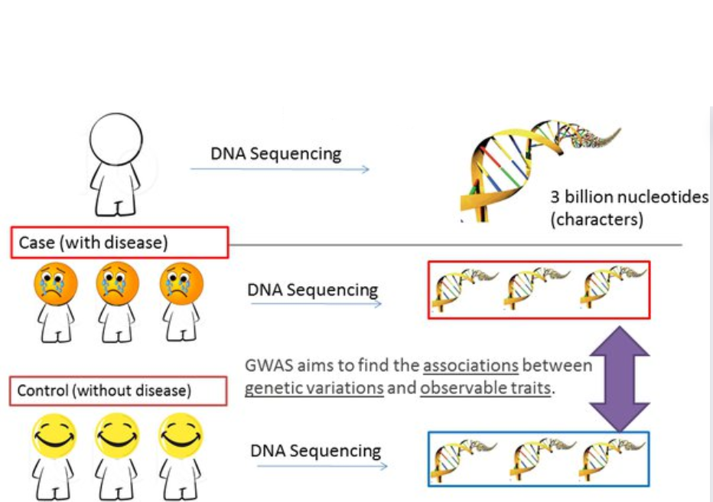
What is GWAS?
GENOME-WIDE ASSOCIATION STUDIES

Slide 20

UNVEILING THE CODE OF LIFE
Module Spit - up

Slide 21
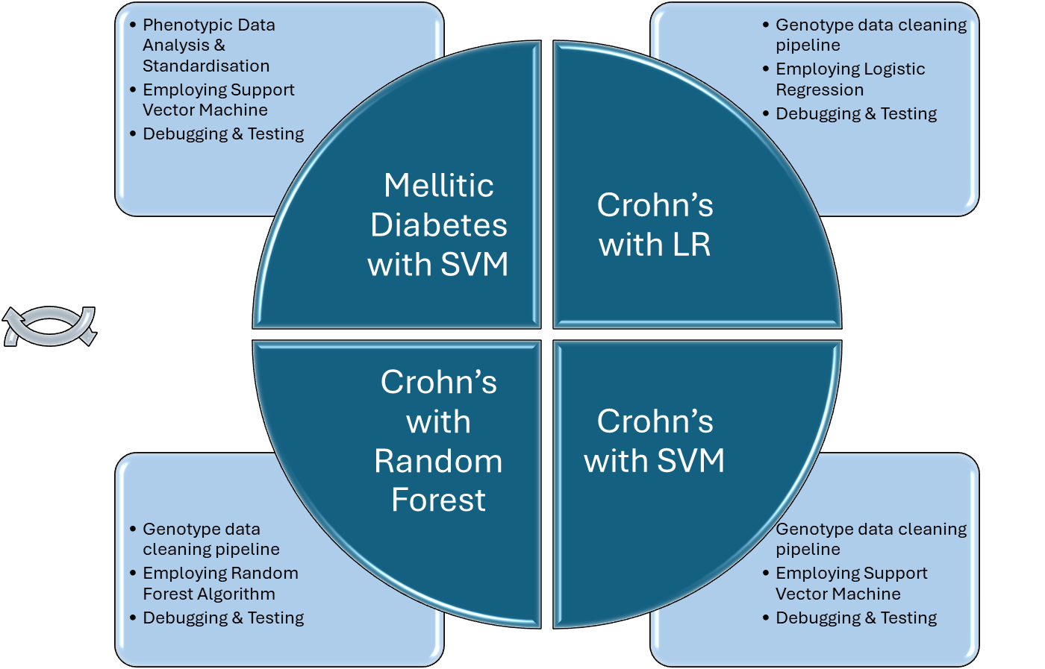
MODULES
and their
Distribution

Slide 22

UNVEILING THE CODE OF LIFE
Working Demonstration

Slide 23
Demonstration
Dataset links:
https://www.dropbox.com/s/uh7o7uyeghqkhoy/diabetes.csv?e=1&dl=0
https://dataverse.unc.edu/file.xhtml?fileId=7183963&version=1.0
Data Cleaning Pipeline:
https://colab.research.google.com/drive/15GAbQ2jZjIqNwYrI7TOWKjvOu0hF9qxg#scrollTo=pSRK9e1Xsivi
Code for Diabetes:
https://colab.research.google.com/drive/10JNSUAoKEn89ZvVcMjP8HsUo1tJpPslC?usp=sharing
Code for IBD:
Random Forest:-https://colab.research.google.com/drive/18oq_GXwjBuOvDm9YSXEEbO5ak9XAXrwz?usp=sharing
Support Vector Machine:-https://colab.research.google.com/drive/1OuhpCmTT0fduaEj0pDCX5Eu6Ghc5H0QI?usp=sharing
Logistic Regression:- https://colab.research.google.com/drive/13hjj_3cwY3RNmQcl795v9lENWsj3R2H5?usp=sharing

Slide 24
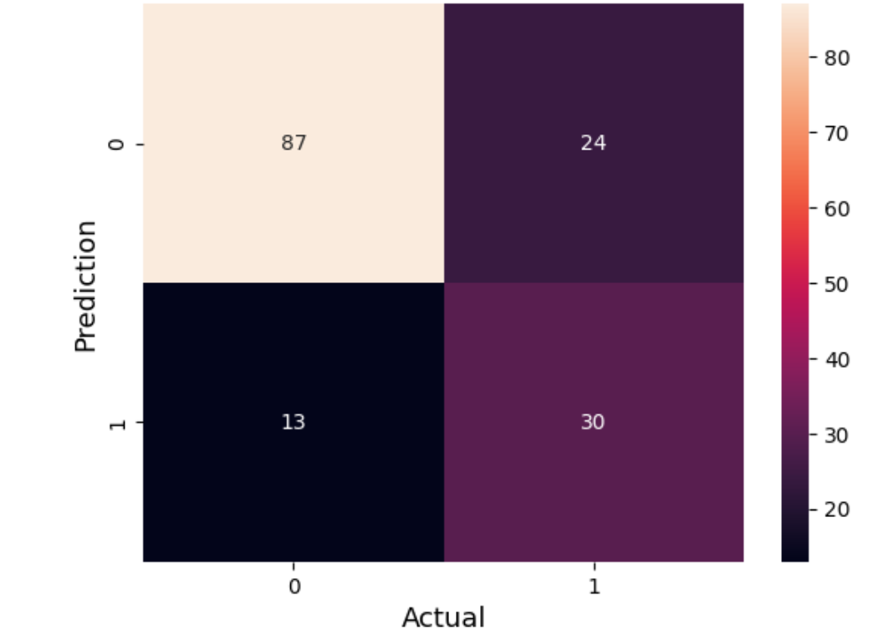
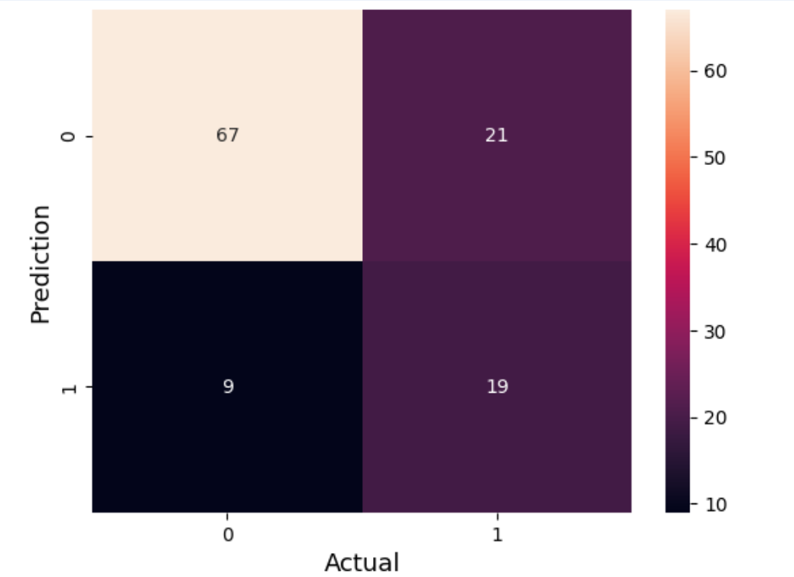
DIABETES
RANDOM FOREST
KNN
CONFUSION MATRIX
CONFUSION MATRIX

Slide 25
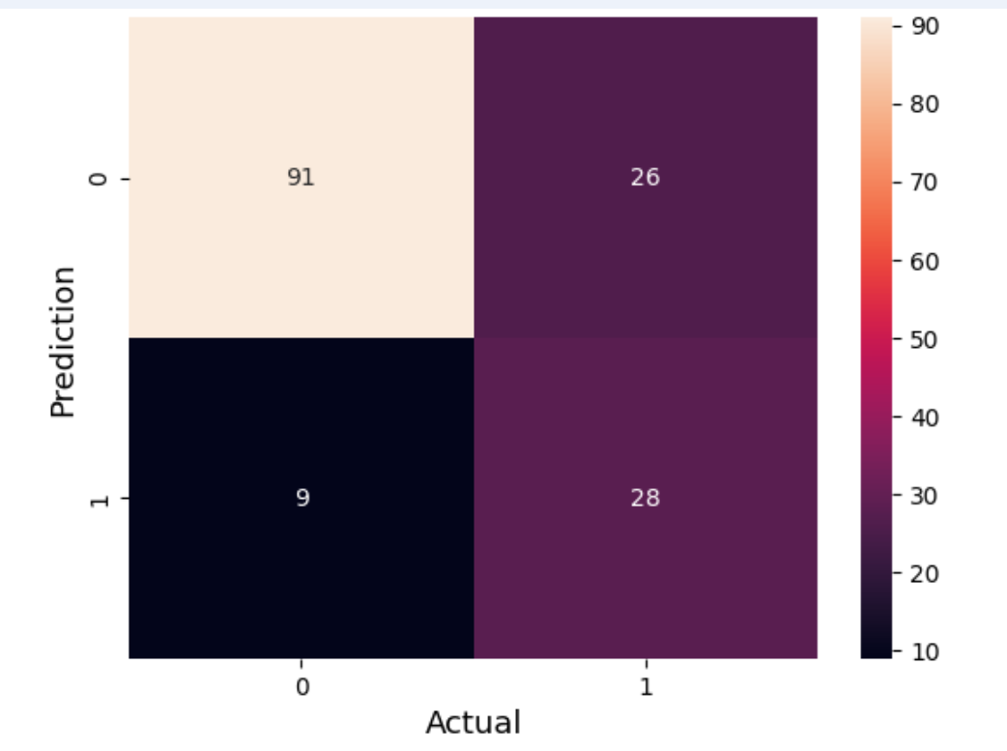
SVM
CONFUSION MATRIX

Slide 26
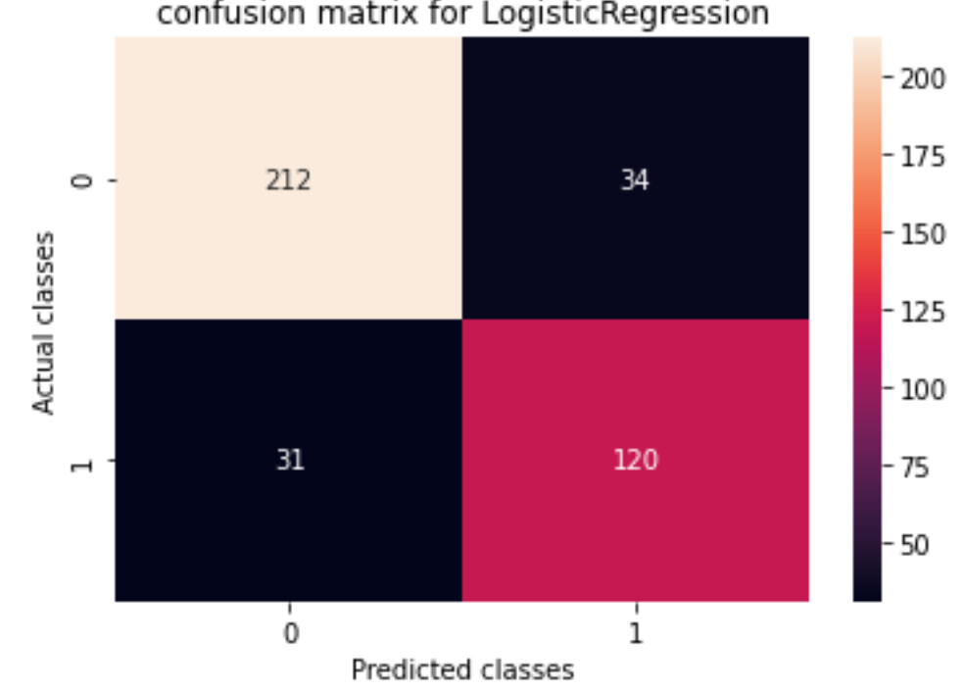
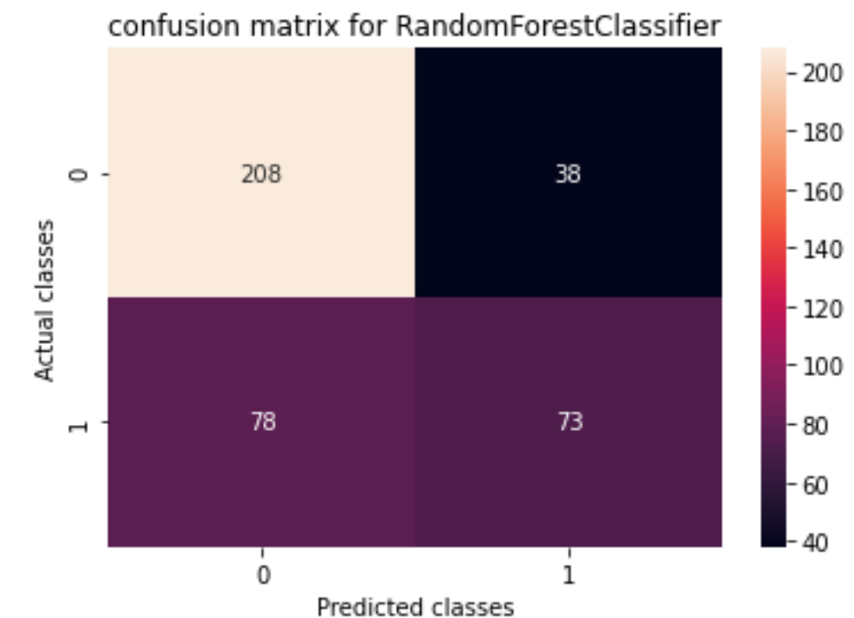
IBD

Slide 27
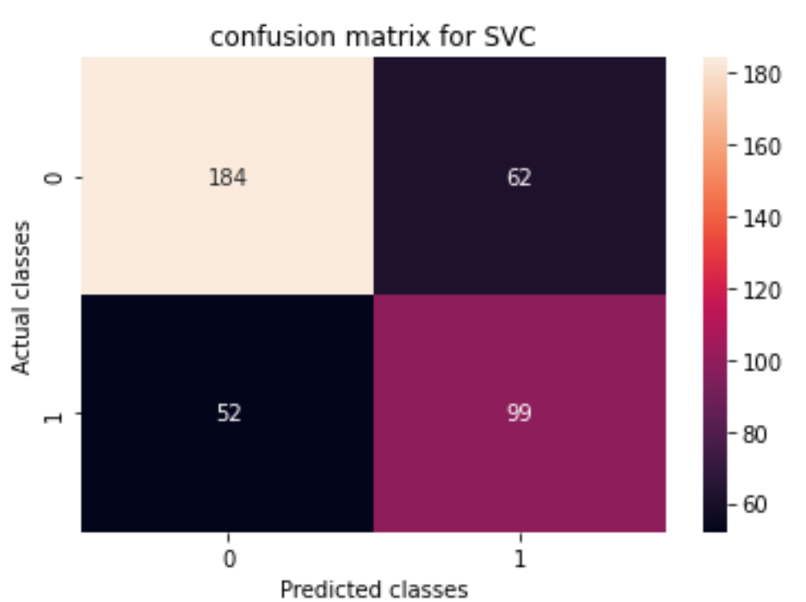

Slide 28
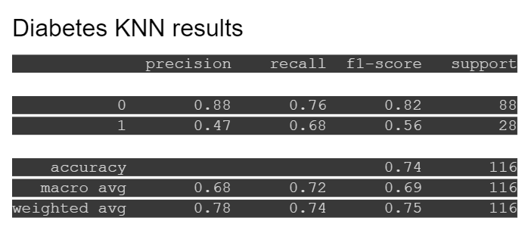
RESULTS

Slide 29
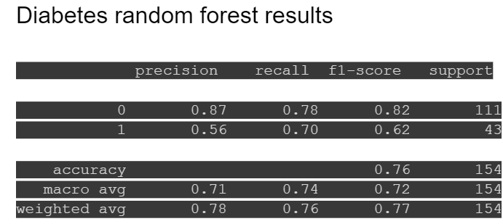
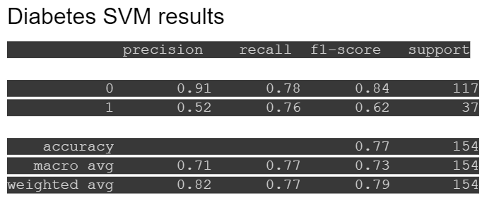

Slide 30
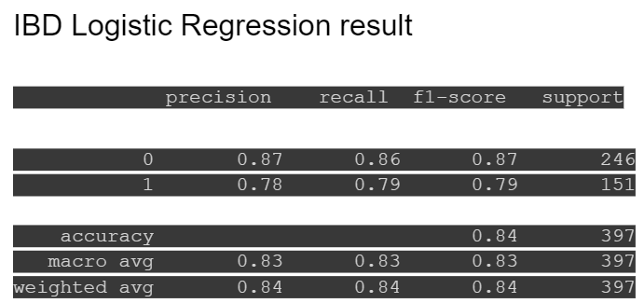
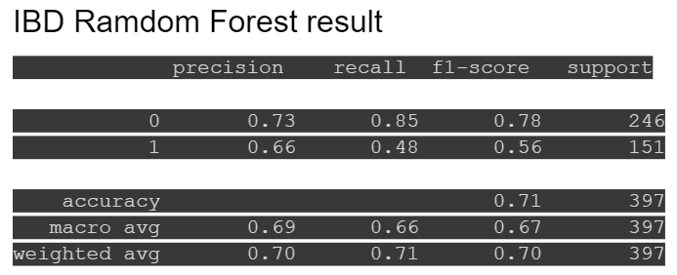

Slide 31
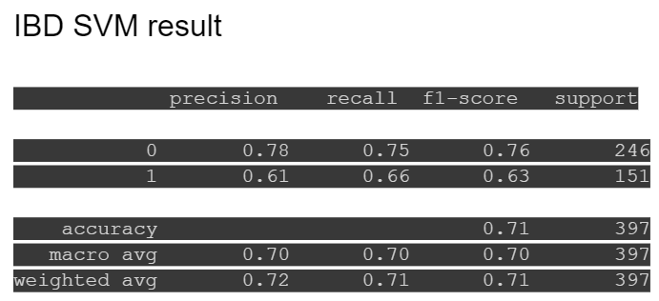

Slide 32

UNVEILING THE CODE OF LIFE
References

Slide 33
REFERENCES
Chatterjee N, Shi J, Garcia-Closas M. Developing and evaluating polygenic risk prediction models for stratified disease prevention. Nat Rev Genet. 2016;advance online publication. pmid:27140283
McCarthy MI, Abecasis GR, Cardon LR, Goldstein DB, Little J, Ioannidis JP, et al. Genome-wide association studies for complex traits: consensus, uncertainty and challenges. Nature reviews genetics. 2008;9(5):356–69. pmid:18398418
Wei Z, Wang W, Bradfield J, Li J, Cardinale C, Frackelton E, et al. Large sample size, wide variant spectrum, and advanced machine-learning technique boost risk prediction for inflammatory bowel disease. The American Journal of Human Genetics. 2013;92(6):1008–12. pmid:23731541
Dissecting Allele Architecture of Early Onset IBD Using High-Density Genotyping Cutler DJ, Zwick ME, Okou DT, Prahalad S, Walters T, et al. Dissecting Allele Architecture of Early Onset IBD Using High-Density Genotyping. PLOS ONE 10(6): e0128074. https://dataverse.unc.edu/api/access/datafile/7183963
Zhou X, Carbonetto P, Stephens M. Polygenic modeling with Bayesian sparse linear mixed models. PLoS Genet. 2013;9(2):e1003264. pmid:23408905
Speed D, Balding DJ. MultiBLUP: improved SNP-based prediction for complex traits. Genome research. 2014;24(9):1550–7. pmid:24963154
Minnier J, Yuan M, Liu JS, Cai T. Risk classification with an adaptive naive bayes kernel machine model. Journal of the American Statistical Association. 2015;110(509):393–404. pmid:26236061

Slide 34
Nguyen, Nghia H., Dominic Picetti, Parambir S. Dulai, Vipul Jairath, William J. Sandborn, Lucila Ohno-Machado, Peter L. Chen, and Siddharth Singh. "Machine learning-based prediction models for diagnosis and prognosis in inflammatory bowel diseases: a systematic review." Journal of Crohn's and Colitis 16, no. 3 (2022): 398-413.
Kraszewski, Sebastian, Witold Szczurek, Julia Szymczak, Monika Reguła, and Katarzyna Neubauer. "Machine learning prediction model for inflammatory bowel disease based on laboratory markers. Working model in a
discovery cohort study." Journal of Clinical Medicine 10, no. 20 (2021): 4745.
Hasan, Md Kamrul, Md Ashraful Alam, Dola Das, Eklas Hossain, and Mahmudul Hasan. "Diabetes prediction using ensembling of different machine learning classifiers." IEEE Access 8 (2020): 76516-76531.
Khanam, Jobeda Jamal, and Simon Y. Foo. "A comparison of machine learning algorithms for diabetes prediction." Ict Express 7, no. 4 (2021): 432-439.

Slide 35

Thank You

